Slide 1



Slide 2
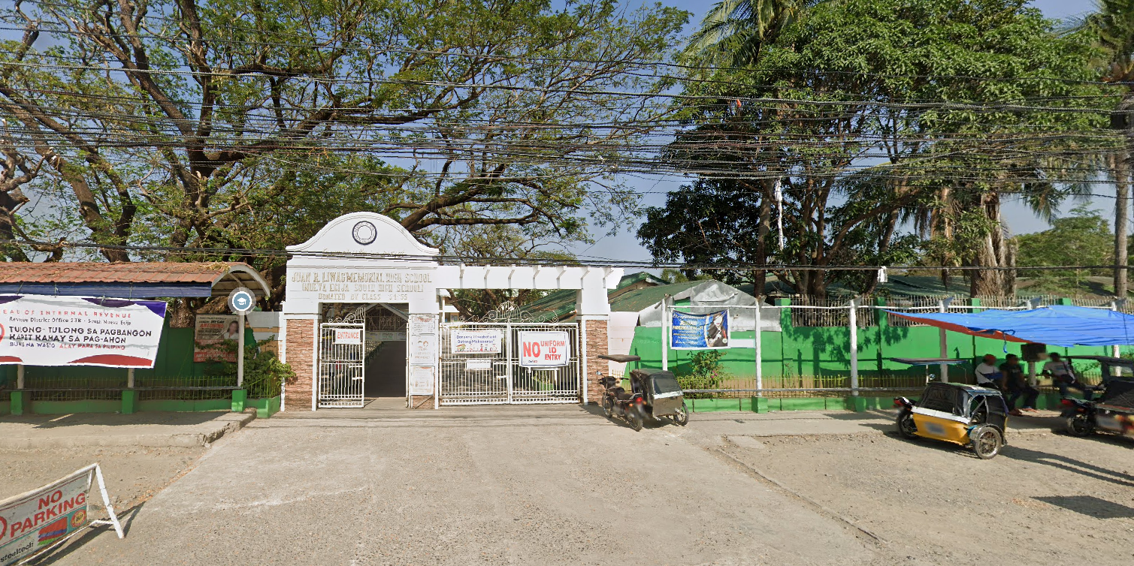

Grade 10
Grade 9
Grade 8
Grade 7
Landmarks

Slide 3
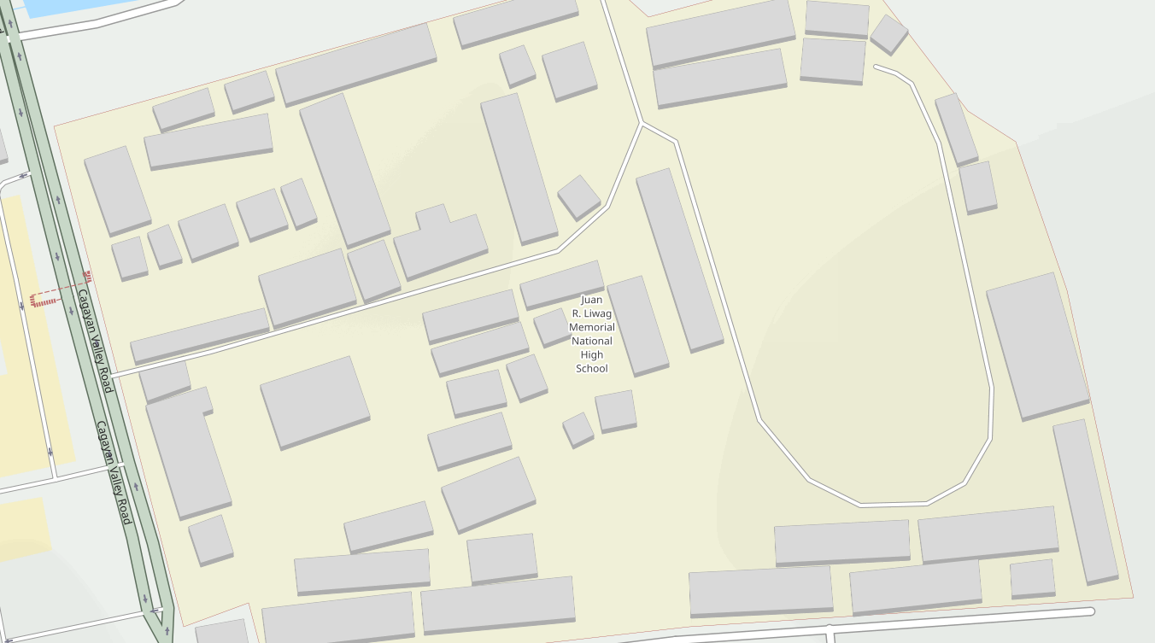

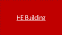


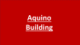




Go back to the Main Entrance

Slide 4
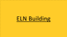
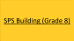
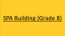
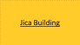

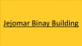
Go back to the Main Entrance

Slide 5




Go back to the Main Entrance

Slide 6




Go back to the Main Entrance

Slide 7
















Go back to the Main Entrance

Slide 8
SPA Building (Grade 7)

Slide 9
HE Building

Slide 10
HE Building

Slide 11
HE Building

Slide 12
Franklin Drilon

Slide 13
New Building

Slide 14
TLE Building

Slide 15
Aquino Building

Slide 16
SPS Building

Slide 17
Jica Building

Slide 18
ELN Building

Slide 19
New Building 2

Slide 20
Jejomar Binay Building

Slide 21
SPS Building (Grade 8)

Slide 22
SPA Building (Grade 8)

Slide 23
Bagong Lipunan Building

Slide 24
Multi-Purpose Building

Slide 25
Del Pilar Building

Slide 26
DOST (Grade 9)

Slide 27
Ralph Recto Building

Slide 28
SPS Building

Slide 29
Values Education Building

Slide 30
MAPEH Building

Slide 31
Clinic

Slide 32
Conference Hall

Slide 33
Covered Court

Slide 34
Rizal Monument

Slide 35
Umali Gym

Slide 36
Oval

Slide 37
Guidance Office

Slide 38
Library

Slide 39
Administration

Slide 40
Canteen

Slide 41
Canteen

Slide 42
Canteen

Slide 43
MAPEH
Learning Center

Slide 44
English
Learning Center

Slide 45
Filipino
Learning Center

Slide 46
TLE
Learning Center

Slide 47
Math
Learning Center

Slide 48
Science
Learning Center

Slide 49
AP
Learning Center

Slide 50
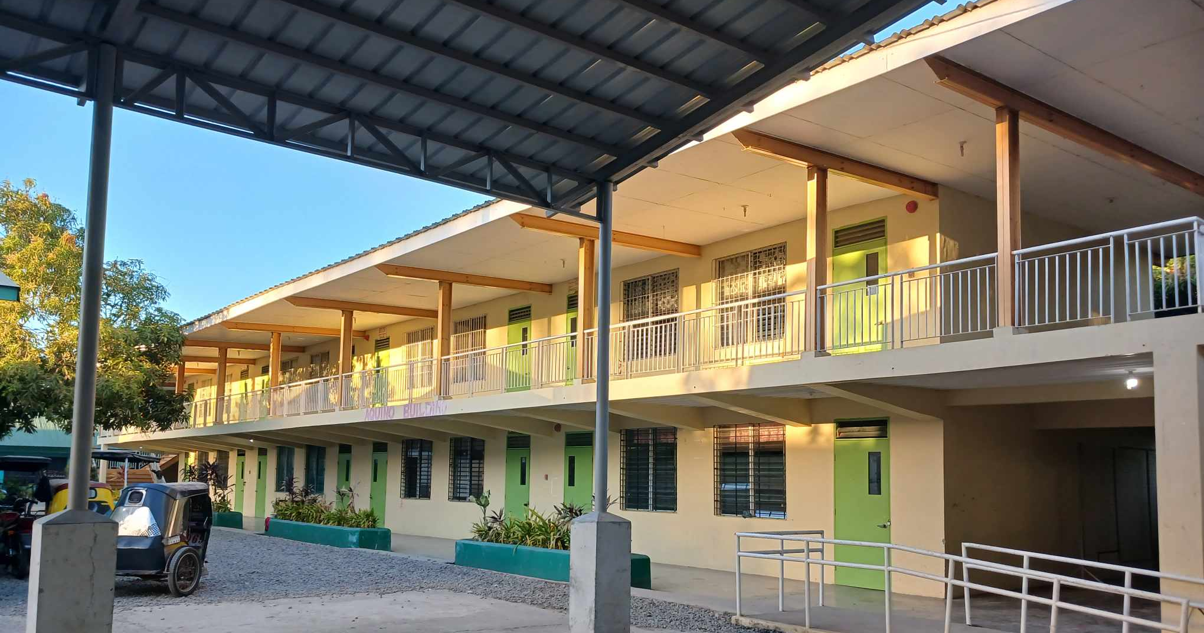
Go back to JRLMHS map
Aquino Building

Slide 51
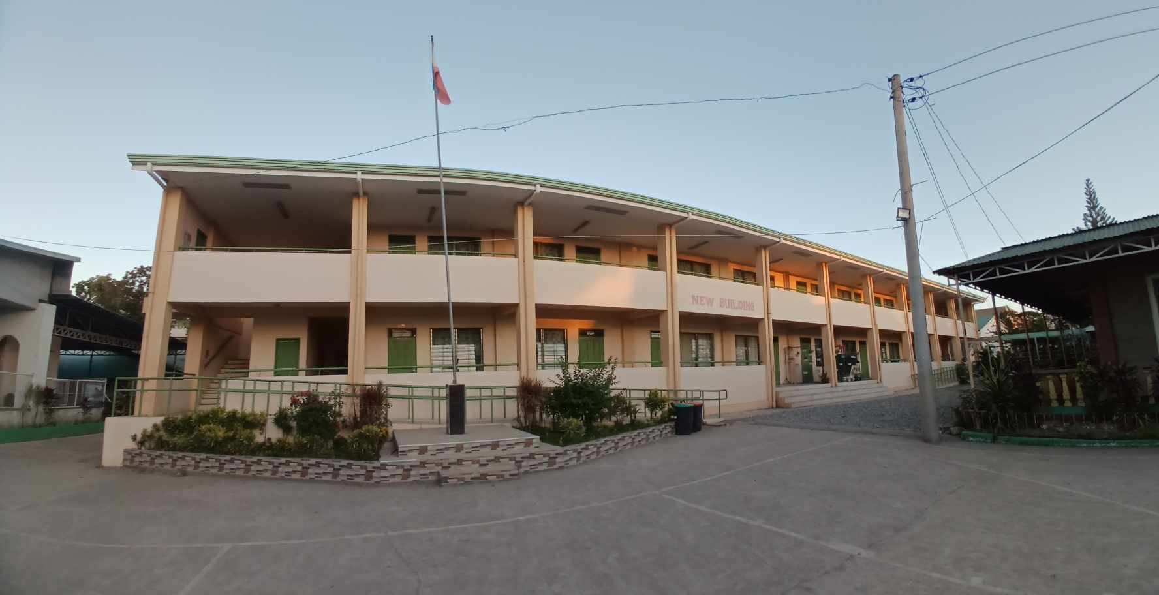
Go back to JRLMHS map
New Building

Slide 52
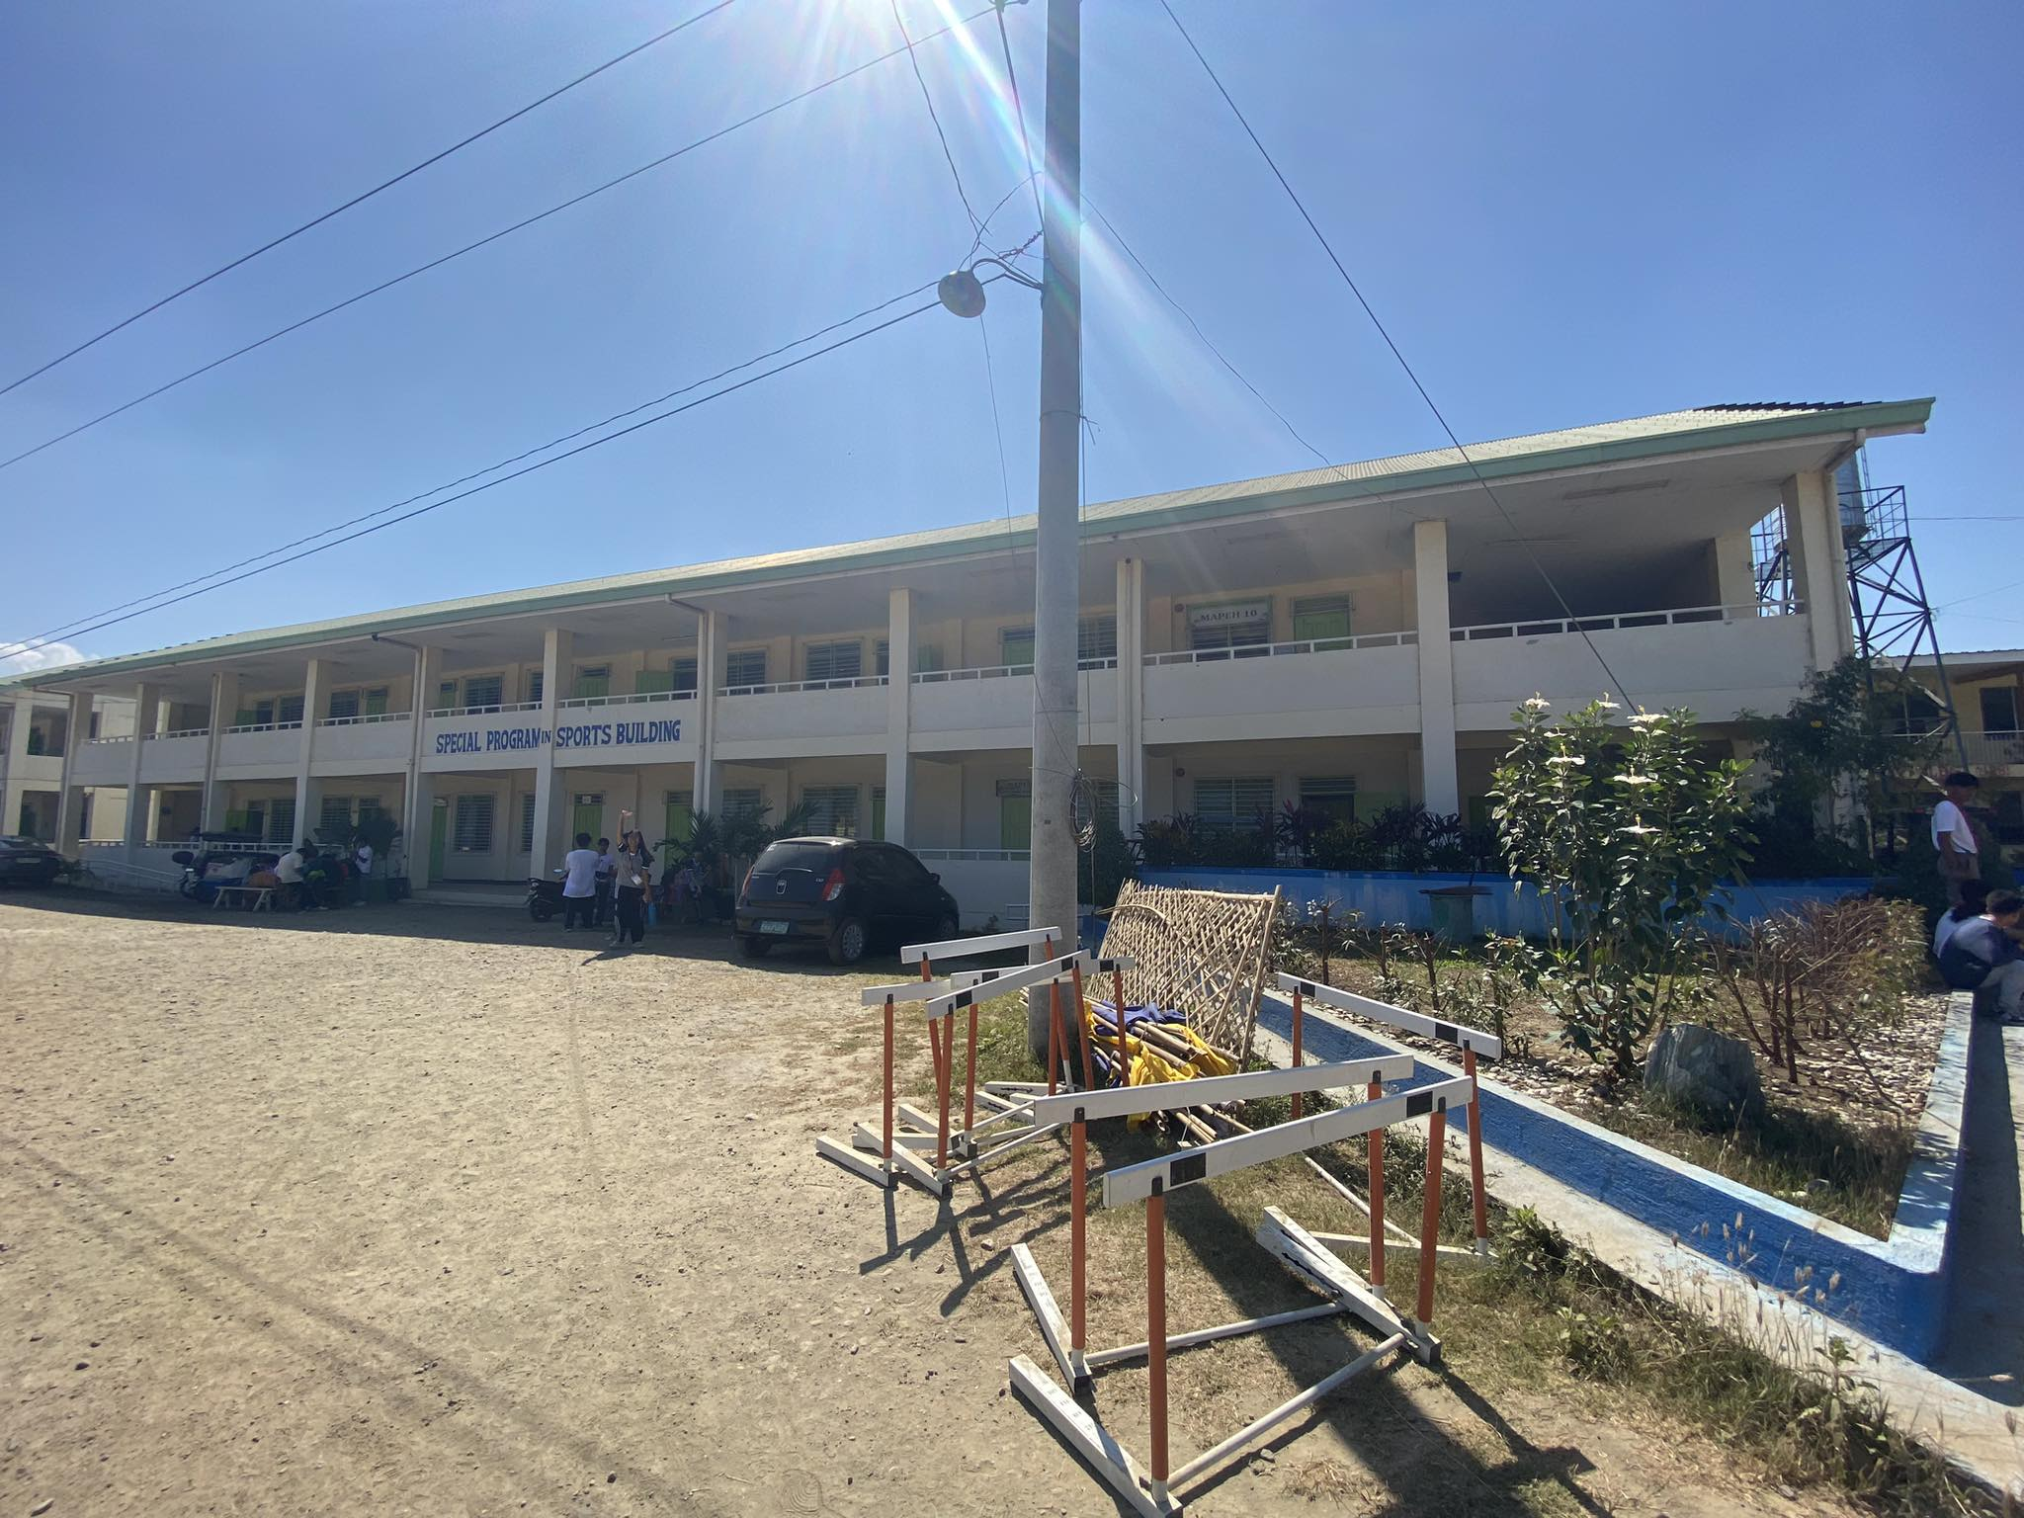
Go back to JRLMHS map
SPS Building
Grade 7

Slide 53
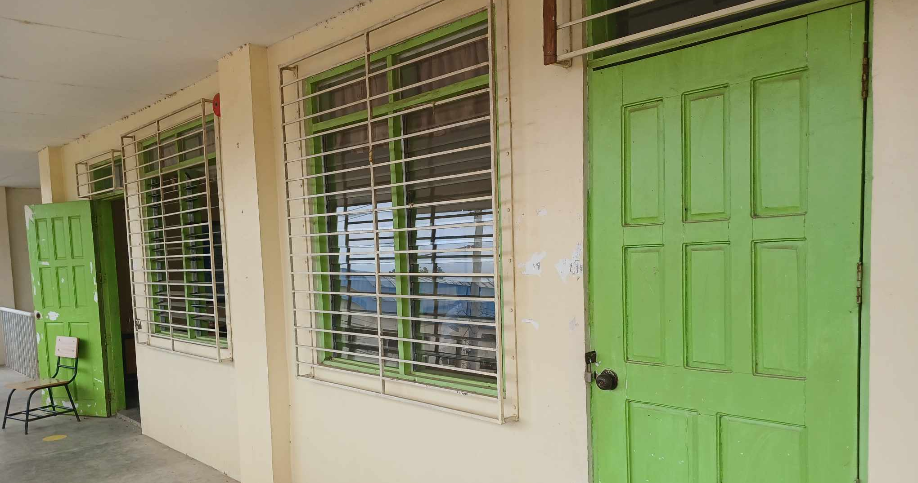
Go back to JRLMHS map
Grade 7

Slide 54
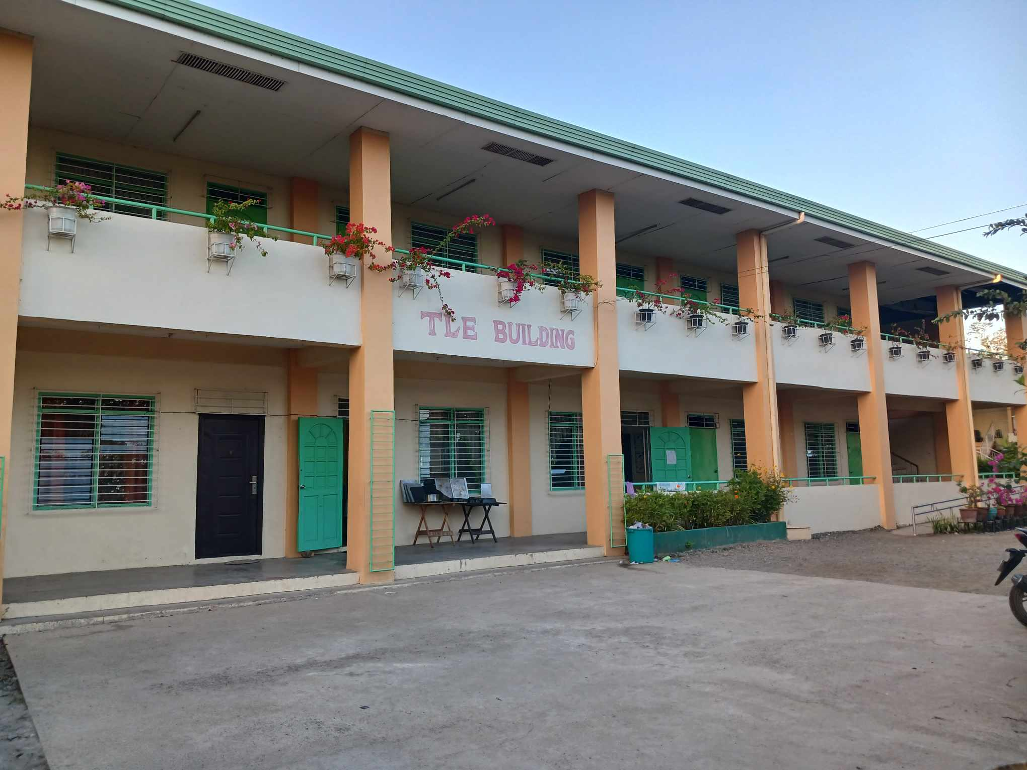
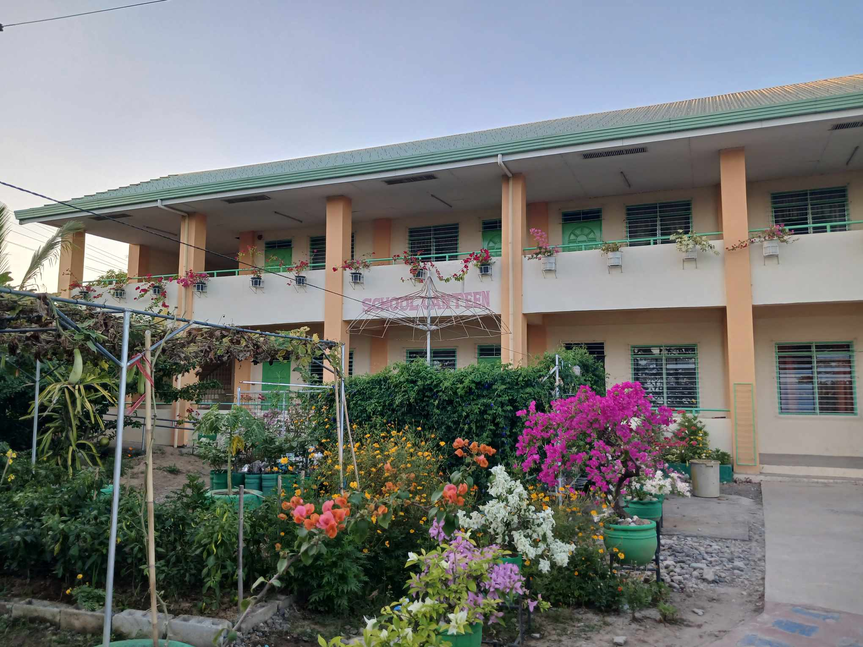
Go back to JRLMHS map
TLE & Canteen

Slide 55
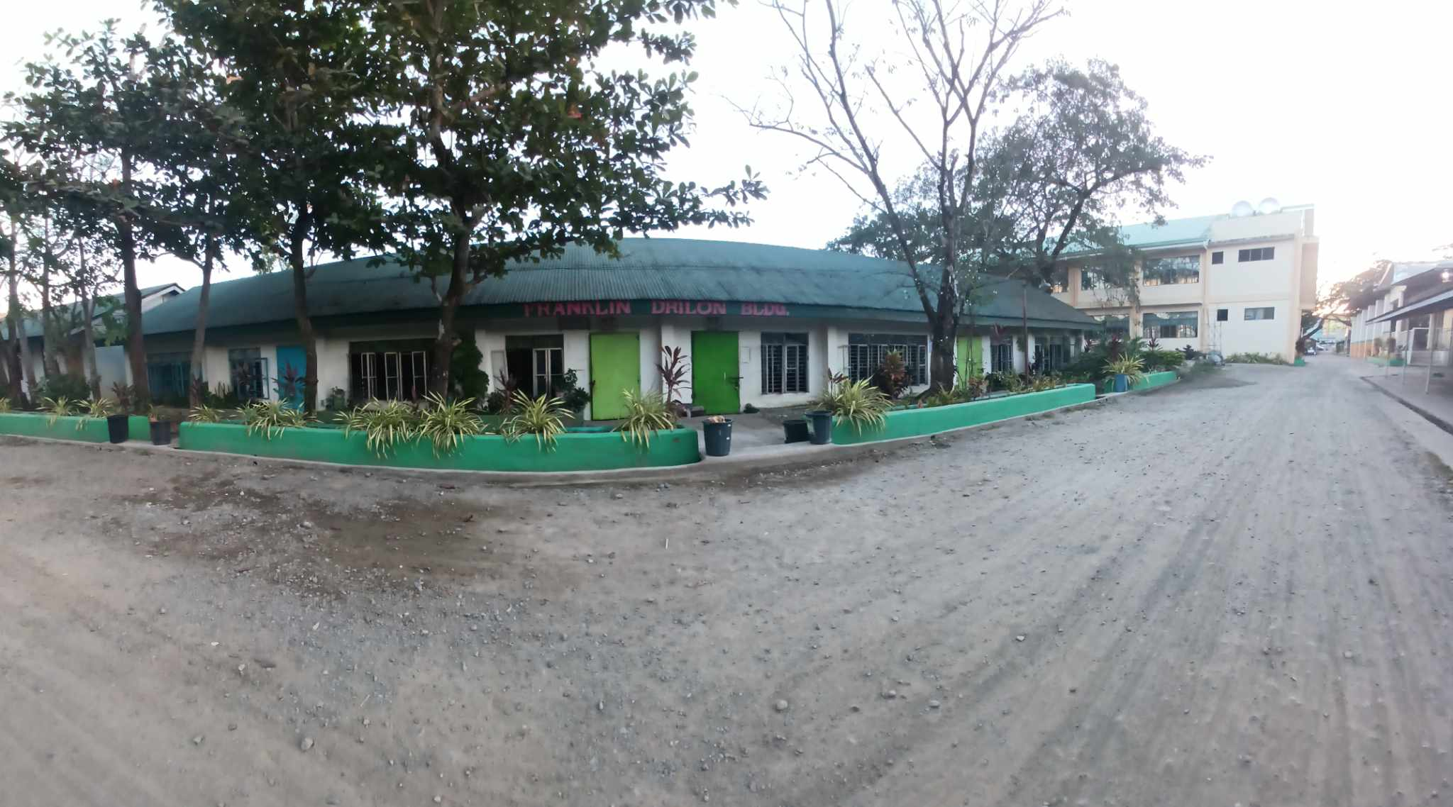
Go back to JRLMHS map
Franklin Drilon Building

Slide 56
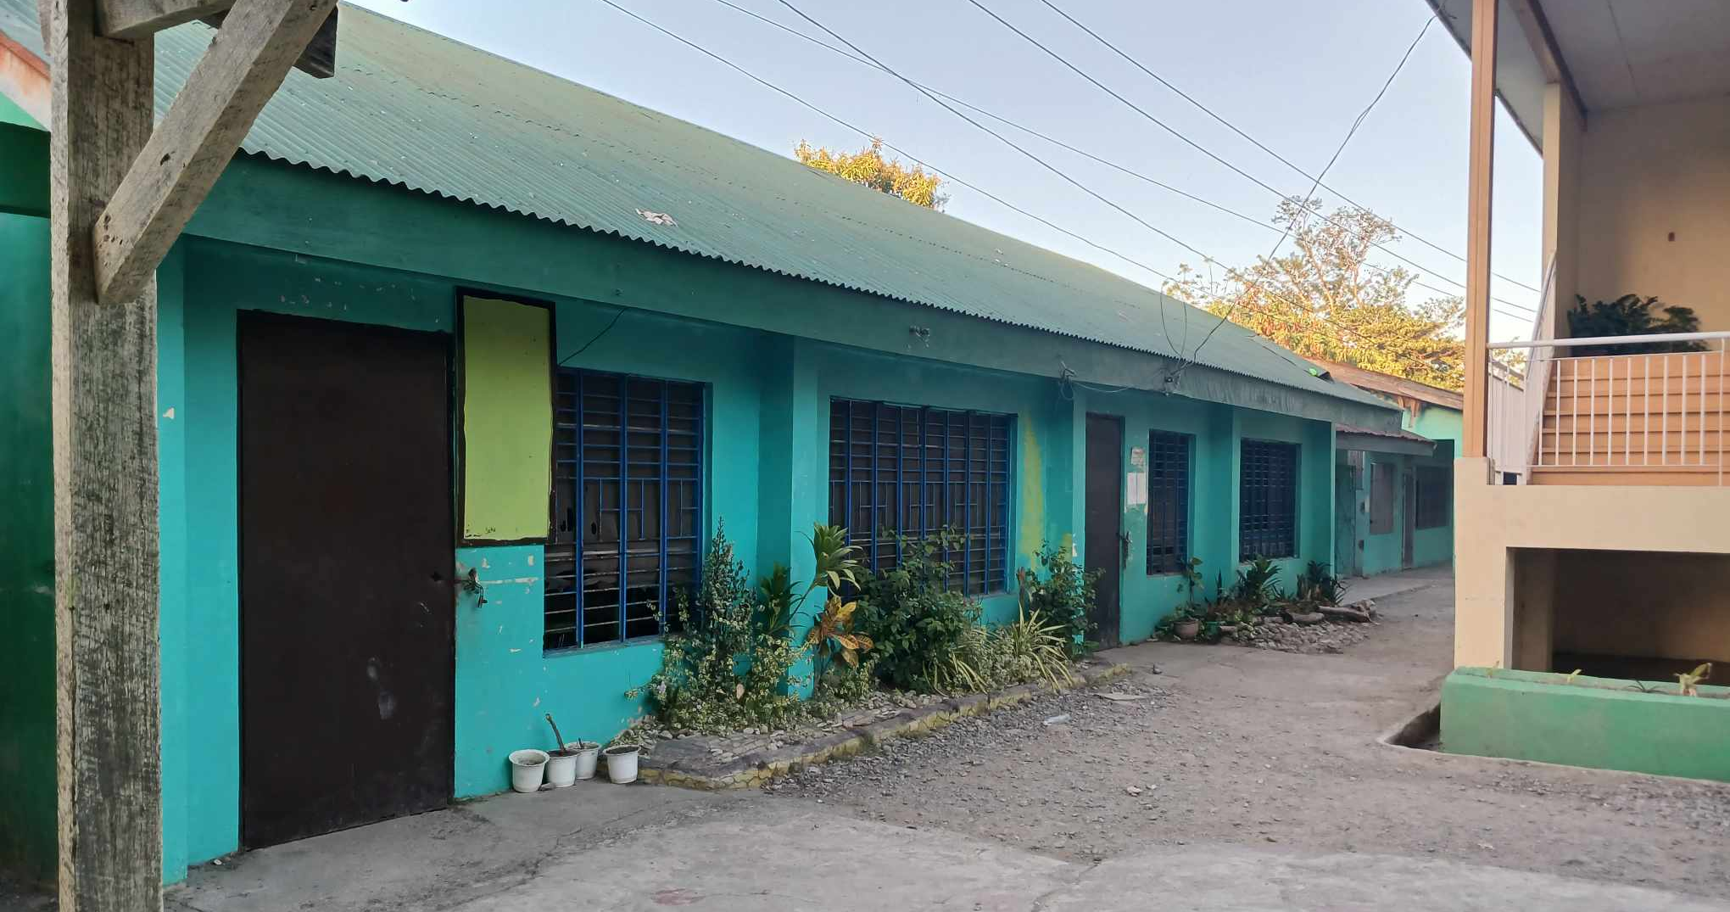
Go back to JRLMHS map
HE Building

Slide 57
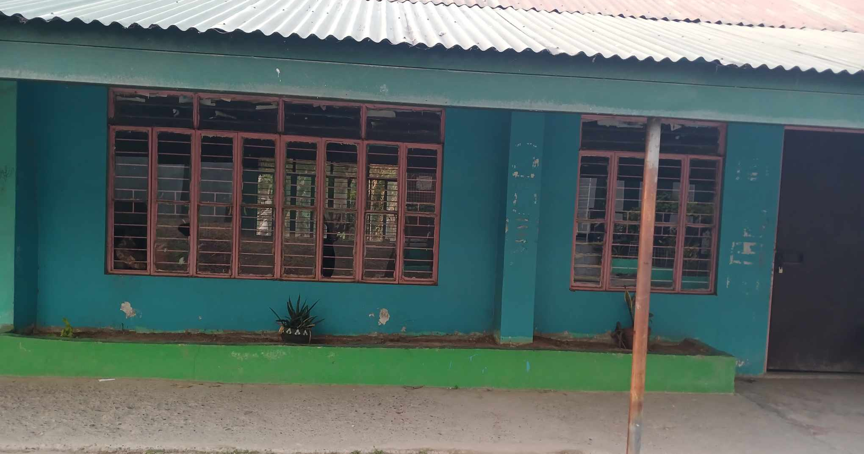
Go back to JRLMHS map
HE Building

Slide 58
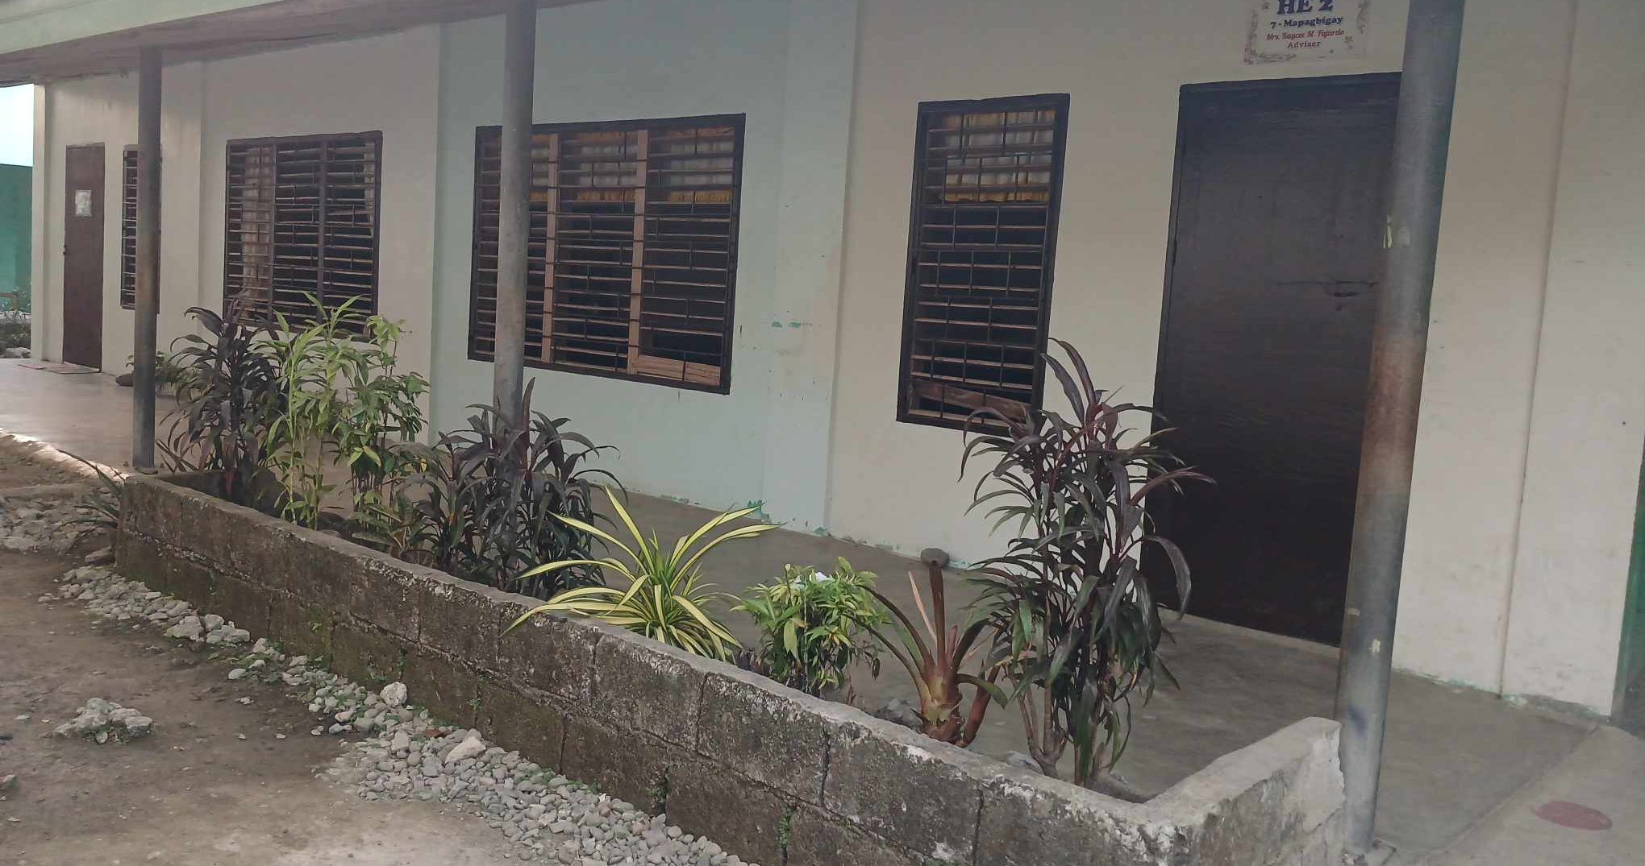
Go back to JRLMHS map
HE Building

Slide 59
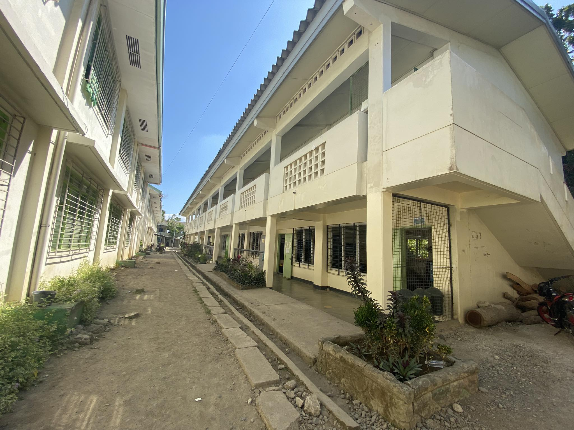
Go back to JRLMHS map
JICA Building

Slide 60
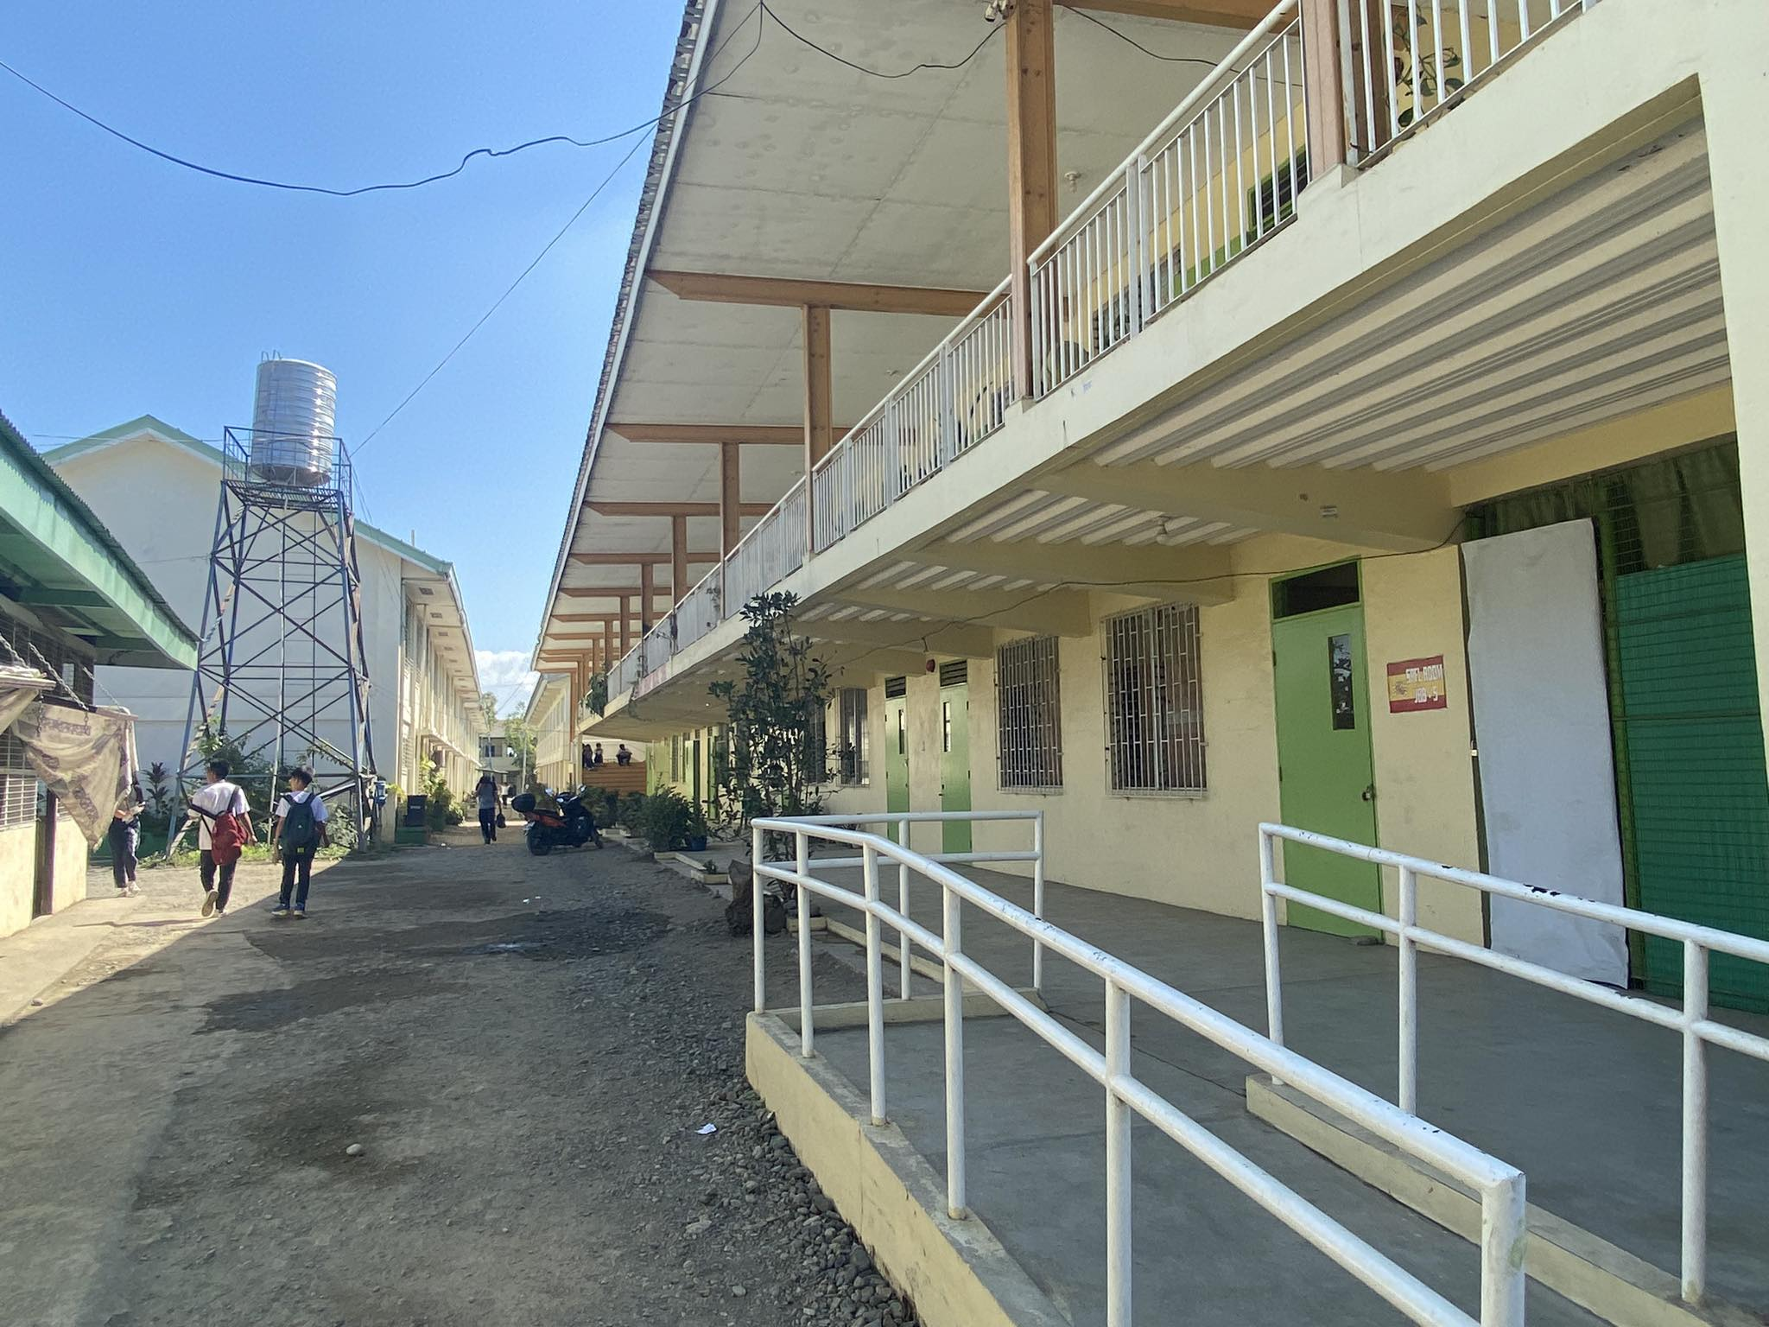
Go back to JRLMHS map
JEJOMAR BINAY Building

Slide 61
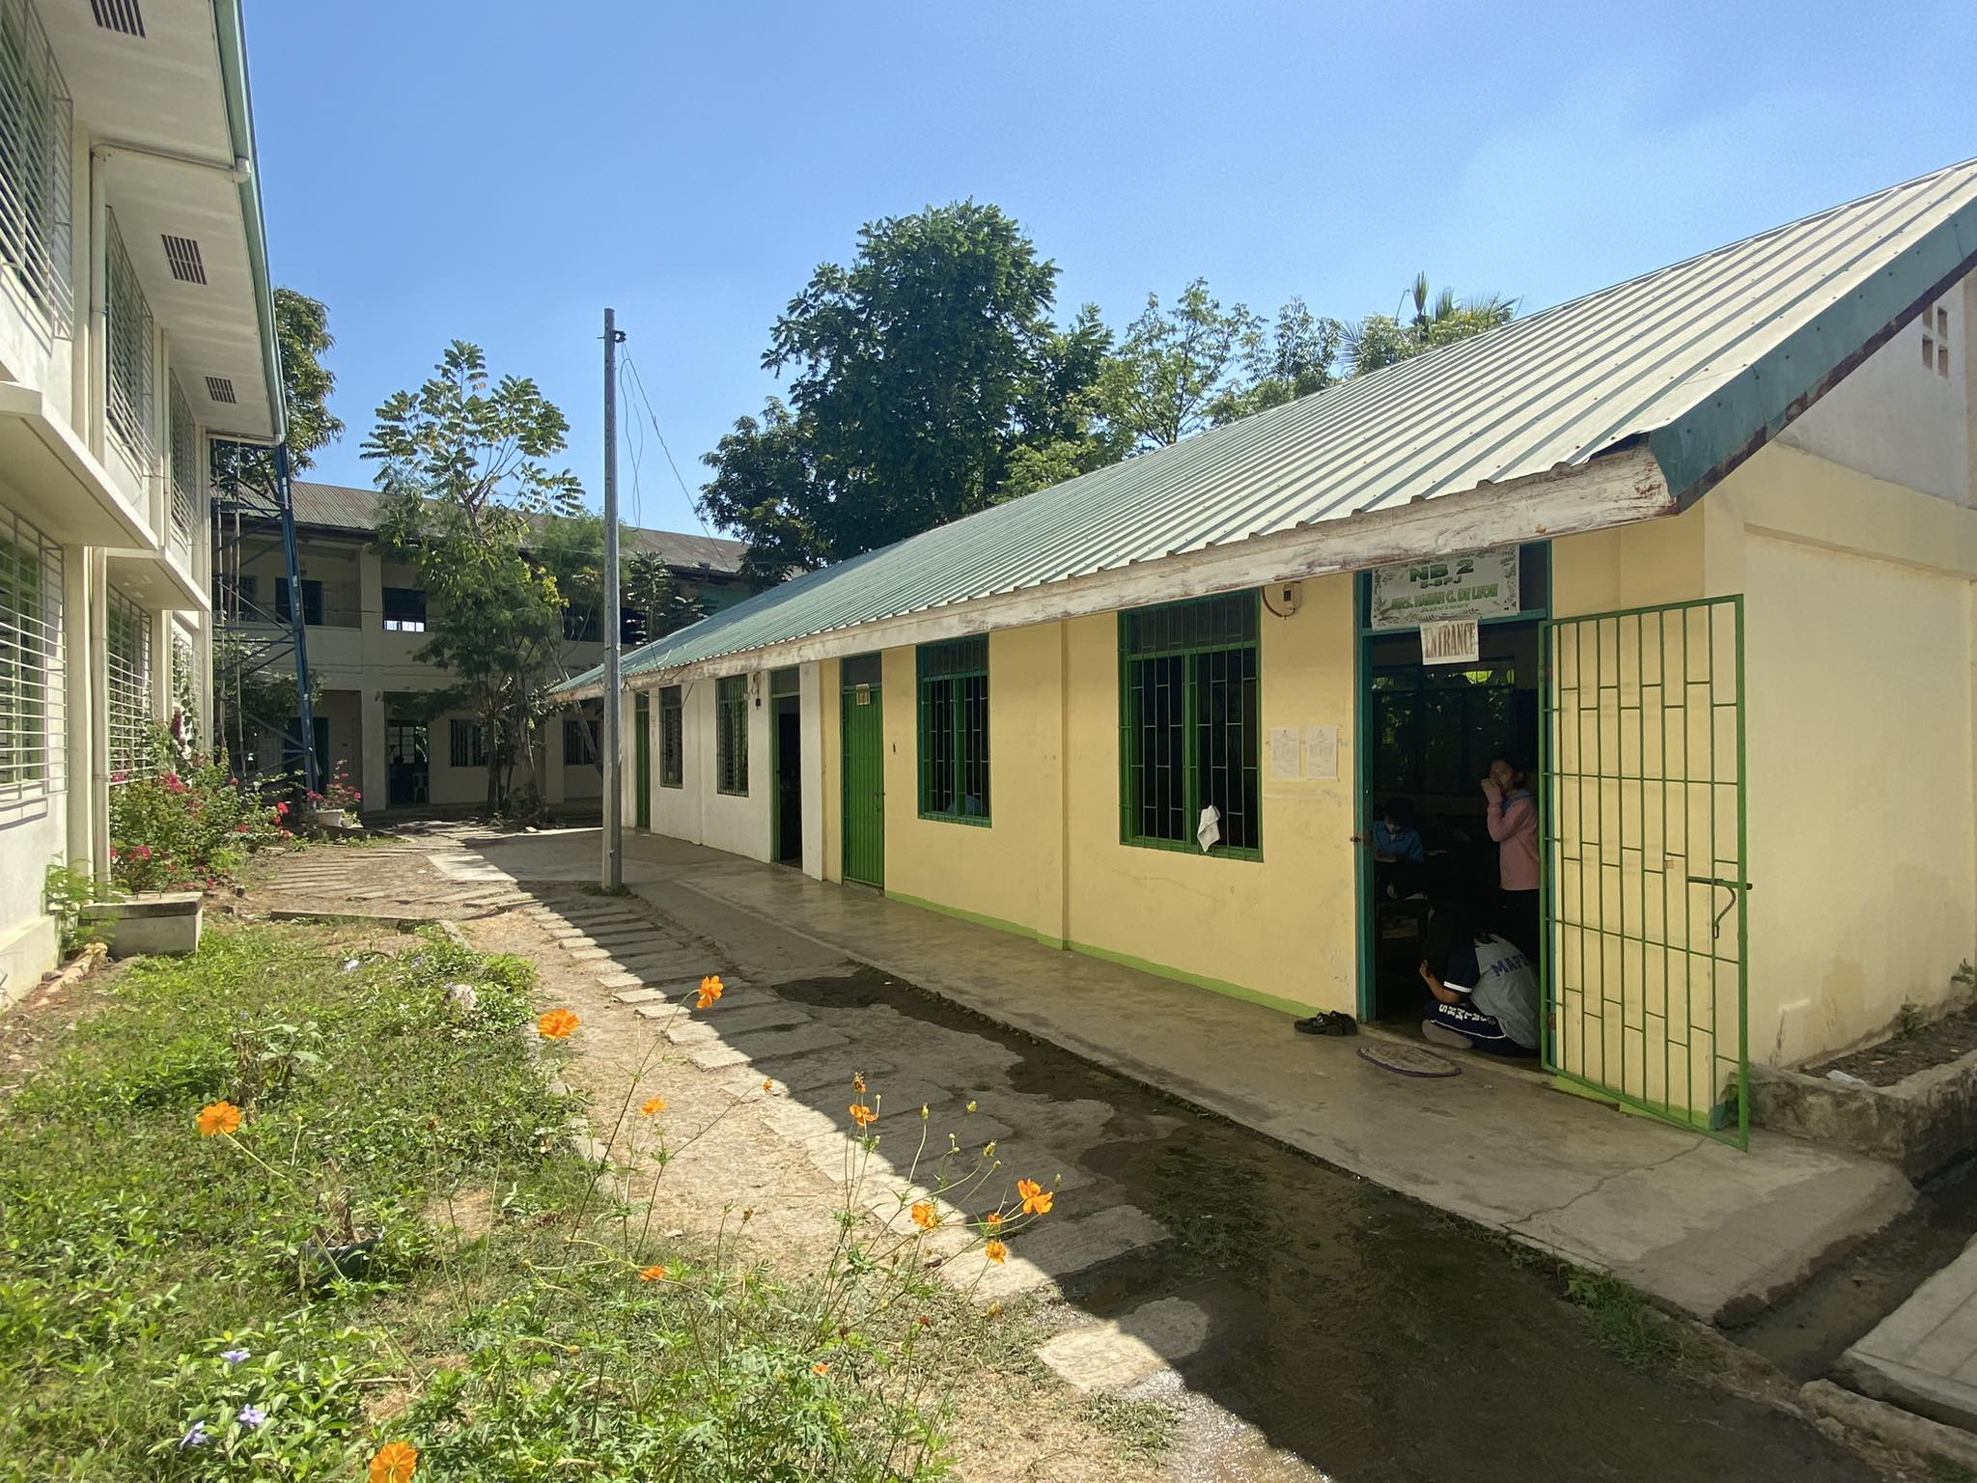
Go back to JRLMHS map
NEW Building 2

Slide 62
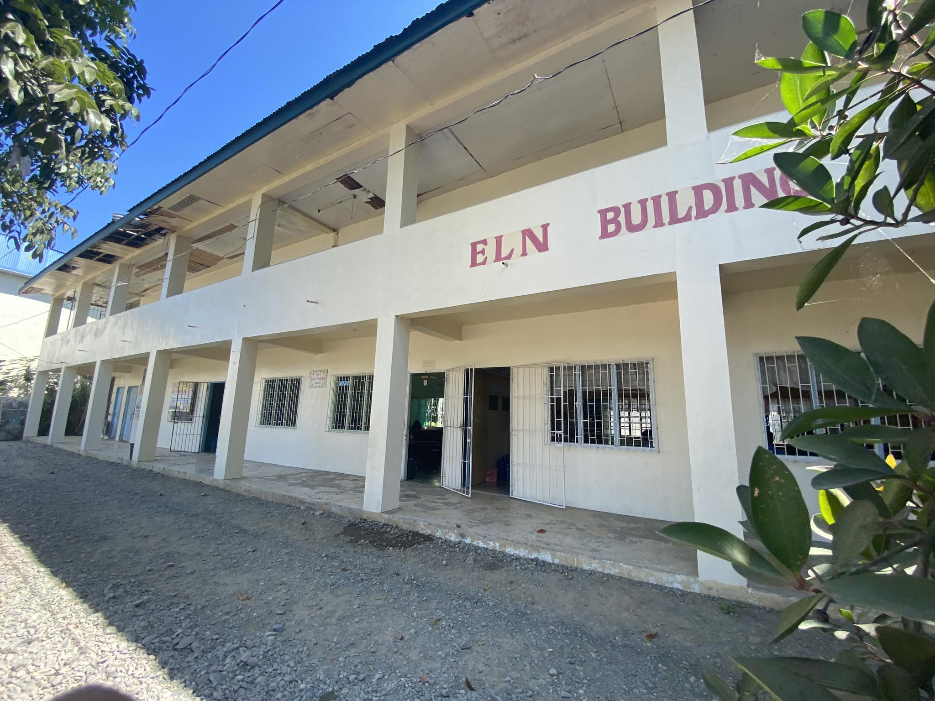
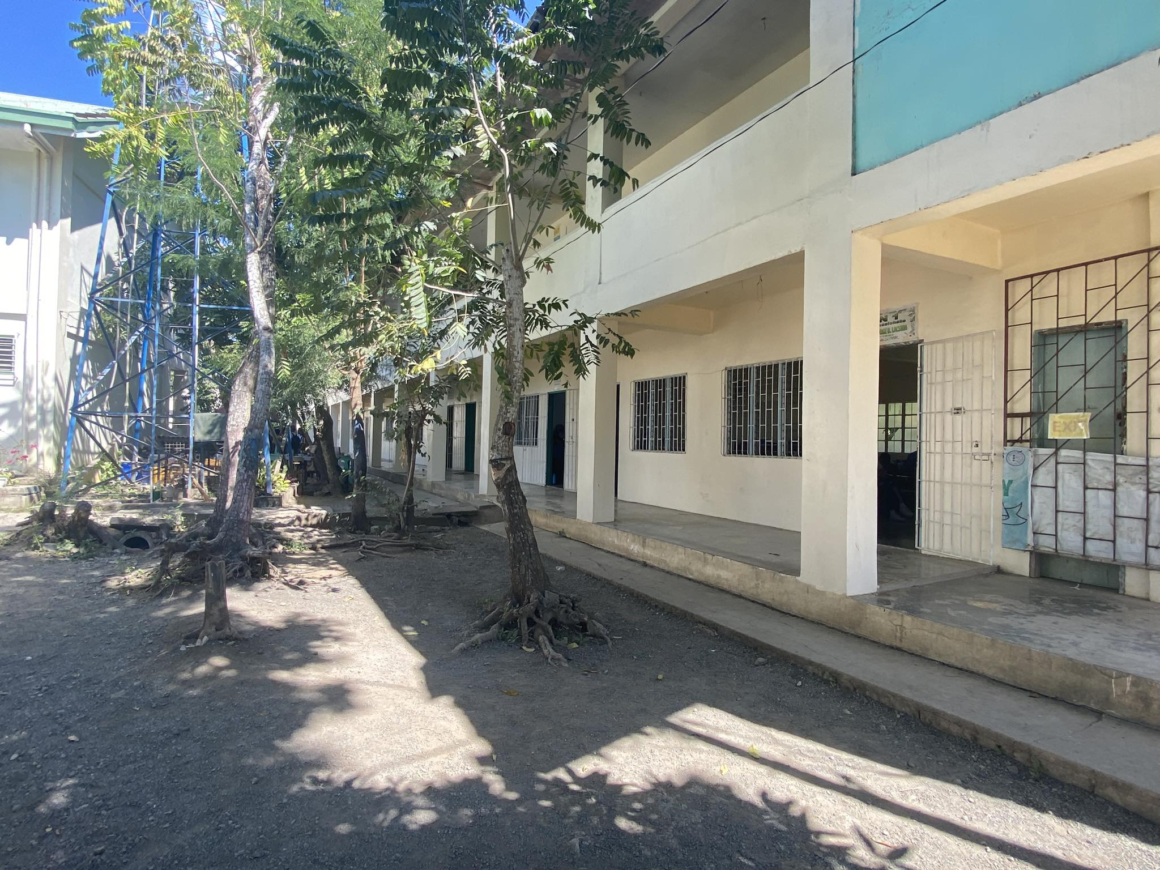
Go back to JRLMHS map
ELN Building

Slide 63
Go back to JRLMHS map
SPS Building
Grade 8

Slide 64
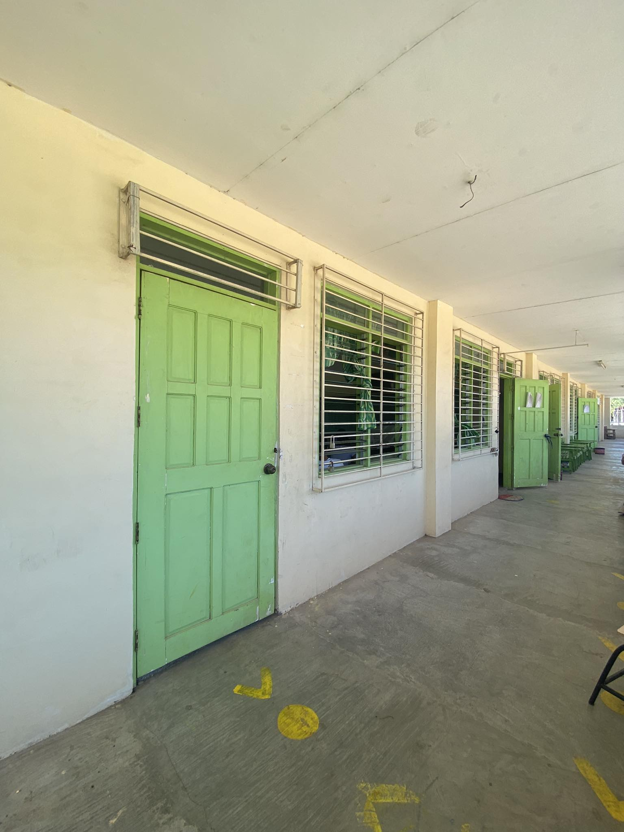
Go back to JRLMHS map
Grade 8 (SPS)

Slide 65
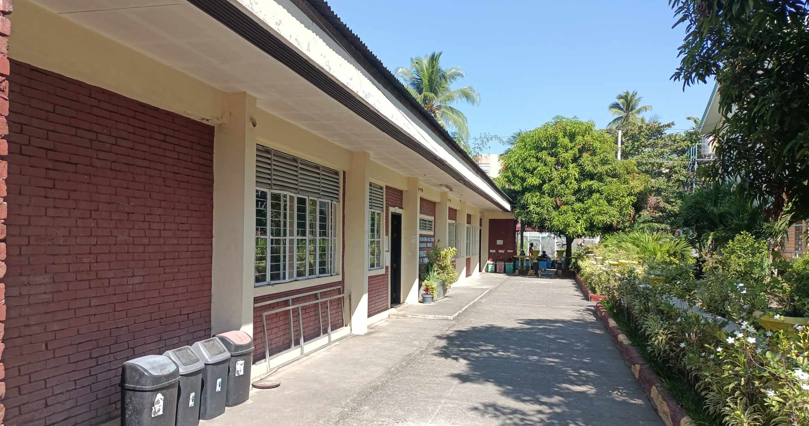
Go back to JRLMHS map
DOST Building

Slide 66
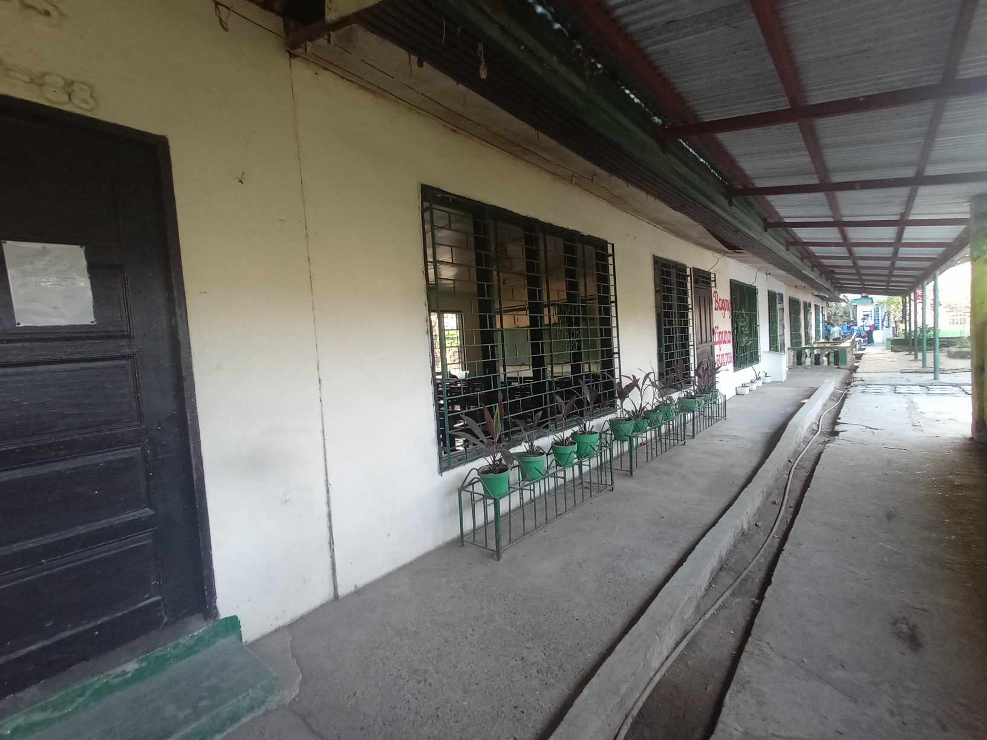
Go back to JRLMHS map
BL Building

Slide 67
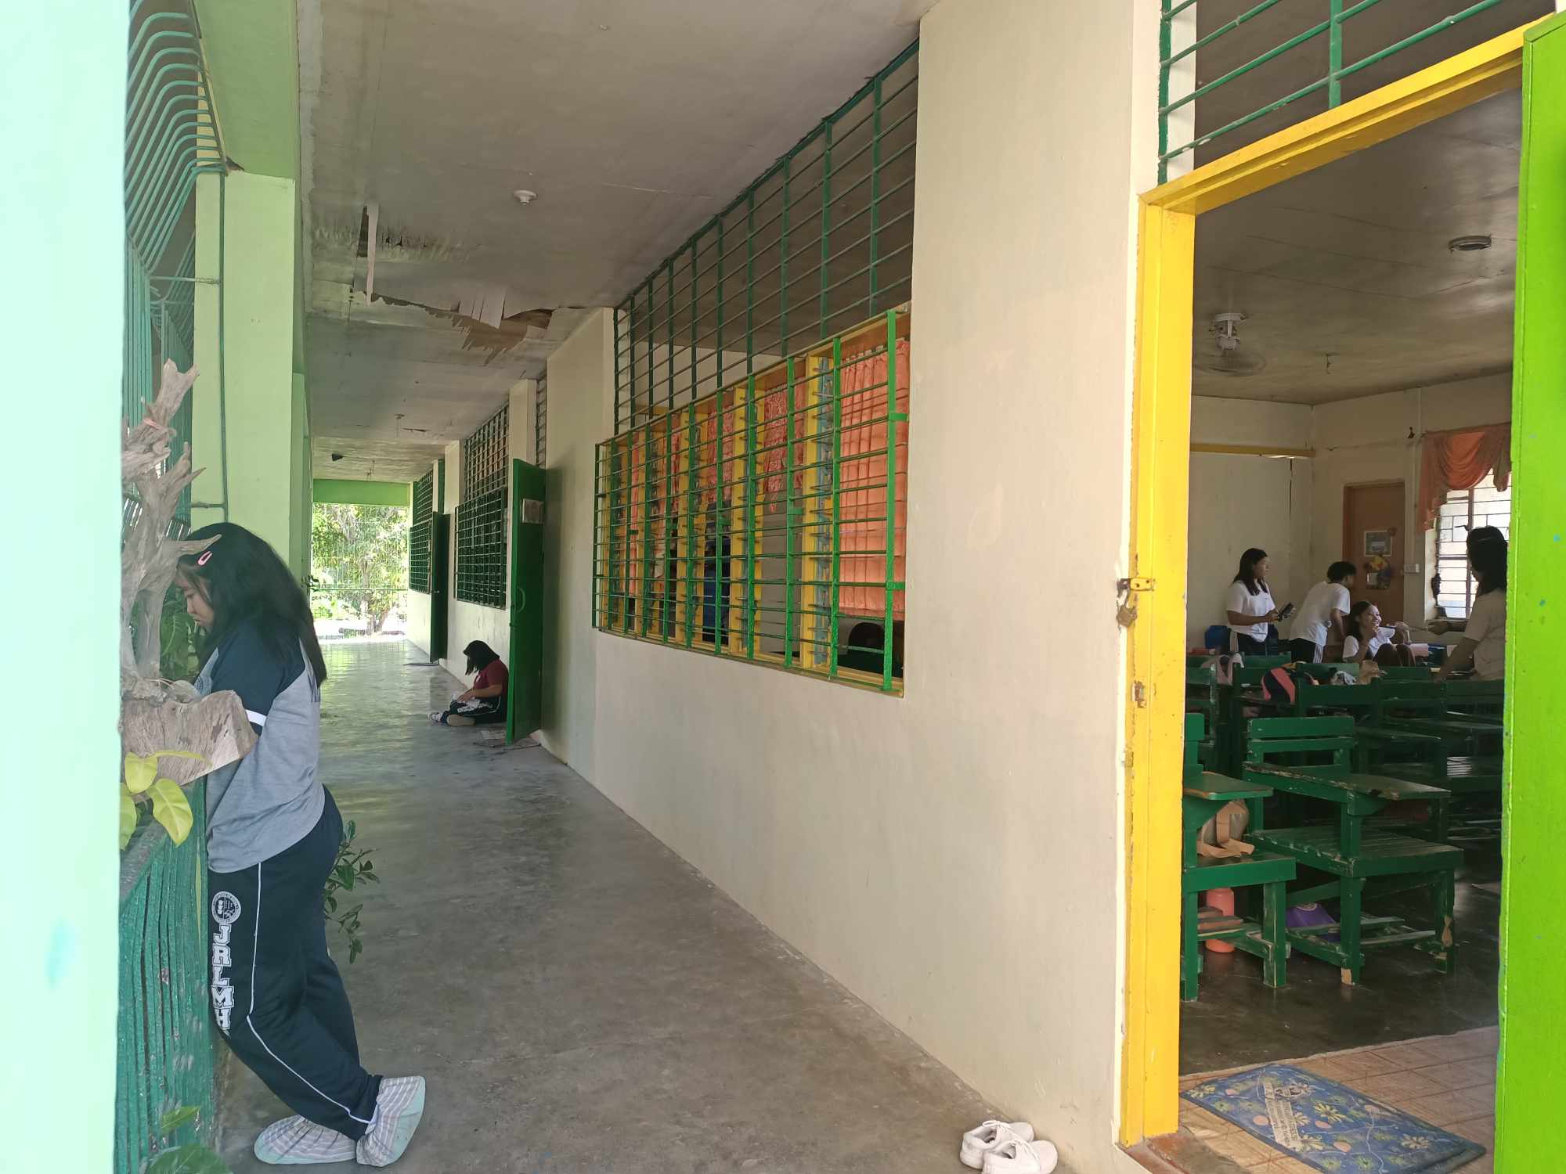
Go back to JRLMHS map
Multi-Purpose Building

Slide 68
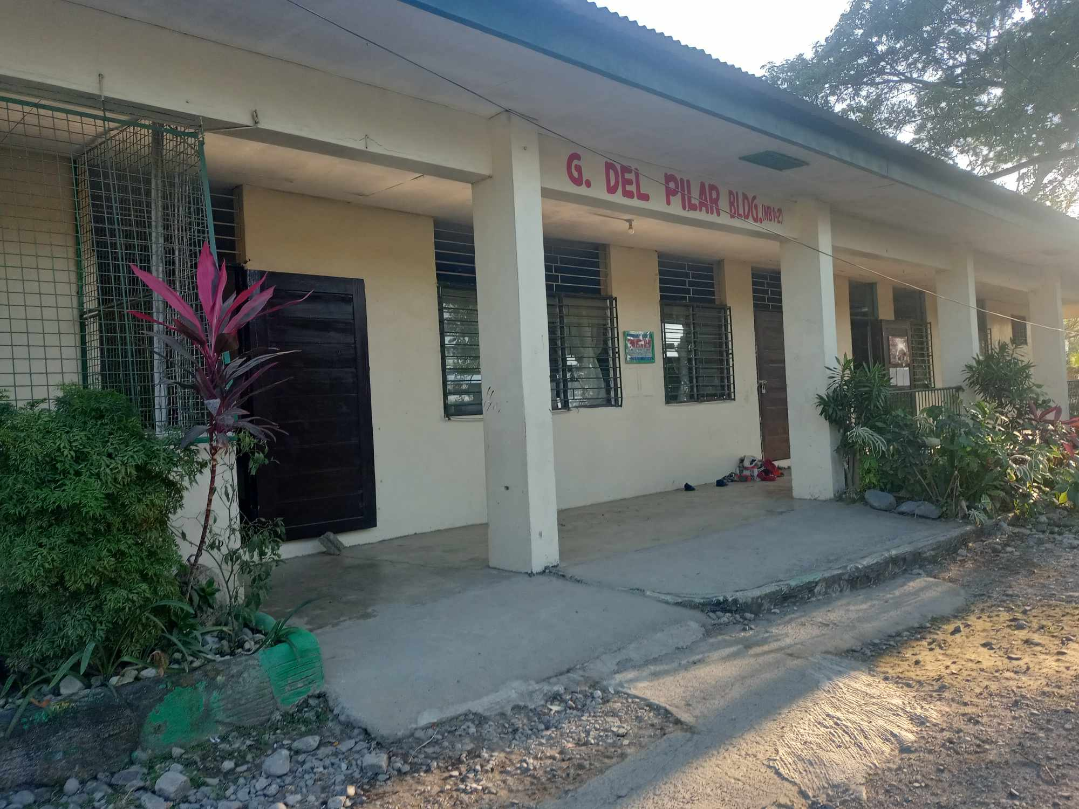
Go back to JRLMHS map
Del Pilar Building

Slide 69
Go back to JRLMHS map
SPS Building

Slide 70
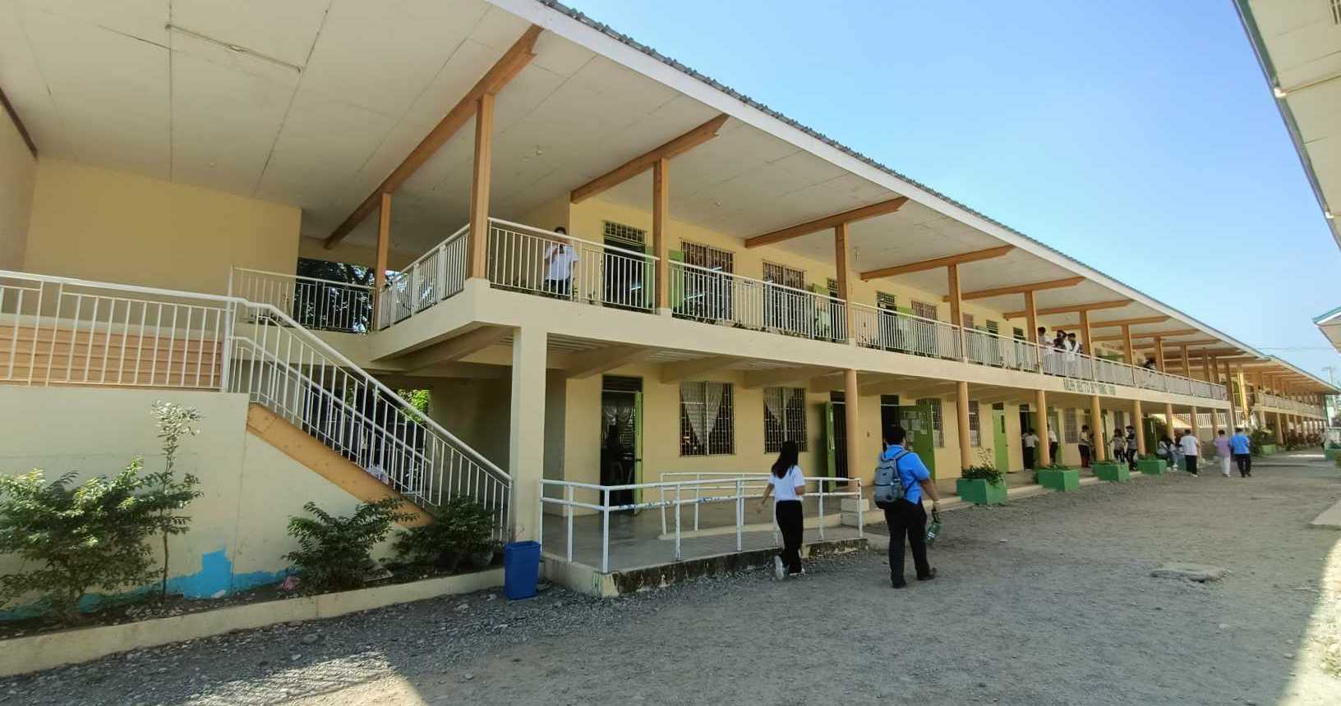
Go back to JRLMHS map
Ralph Recto Building

Slide 71
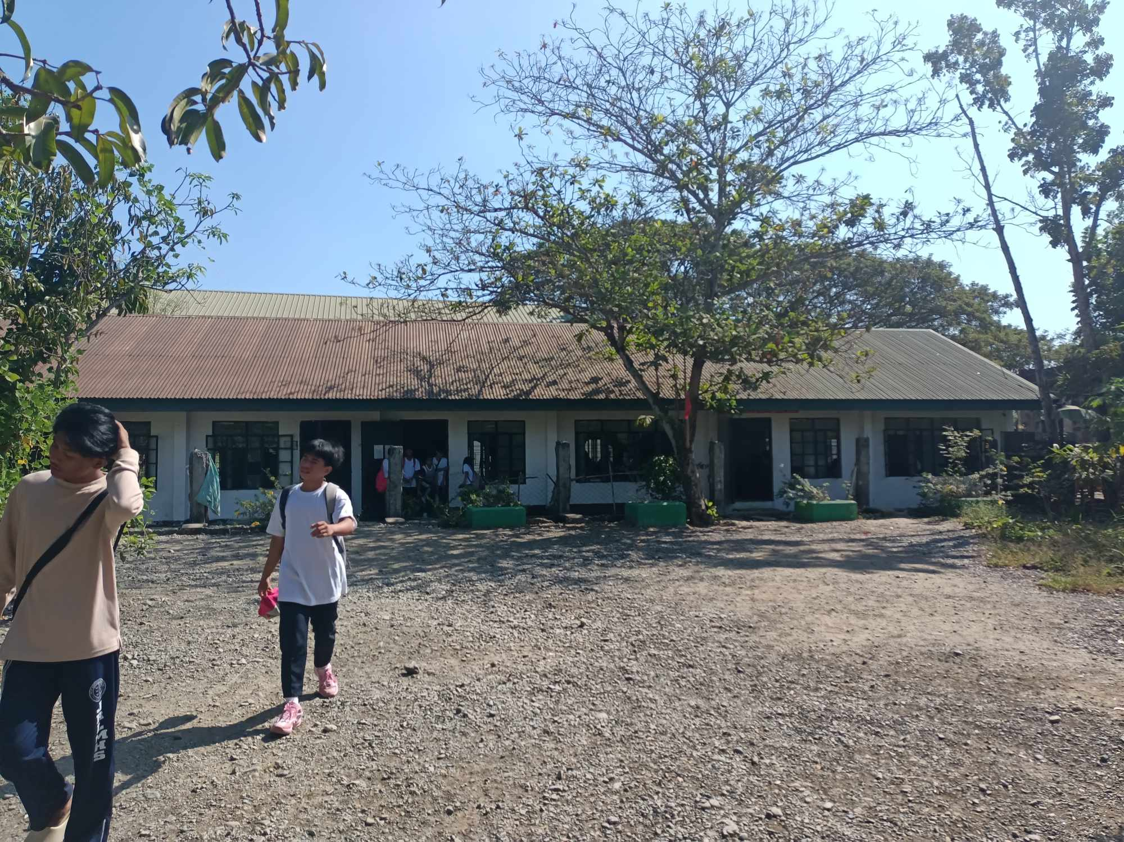
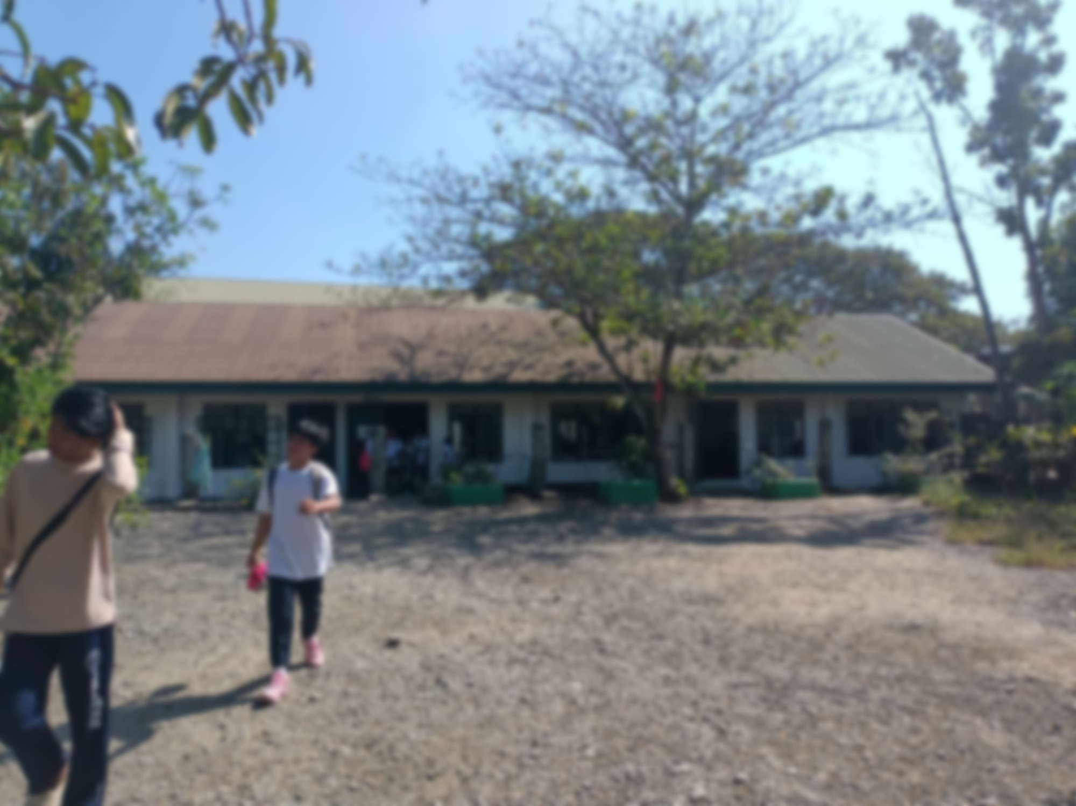
Go back to JRLMHS map
MAPEH Building

Slide 72
Go back to JRLMHS map
SPS Building

Slide 73
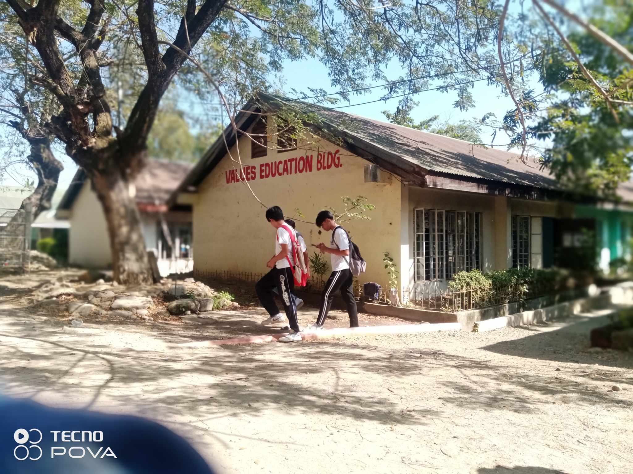
Go back to JRLMHS map
Values Education Building

